Slide 1


SpaceAware: Enhancing Space Situational Awareness
Satellite Orbital Anomalies
Detection and Prediction
Presented by
Kruti Ray
Katia Paredes
The Stellars
Datathon 2025

Slide 2



SpaceAware: Enhancing Space Situational Awareness
Meet The Stellars
Kruti Ray
Katia Paredes
Data Analyst and Data Visualization
Project Lead and Data Visualization
Analyst with 3+ years of experience in product analysis, KPI reporting, and stakeholder engagement, driving data-driven decisions and process improvements.
Project manager with 7+ years of market research experience delivering data-driven solutions supporting business growth.
The Stellars
Datathon 2025

Slide 3
Providing insights for sustainable space operations
Enhancing Space Situational Awareness Through Orbital Anomaly Detection and Prediction
Growing satellite congestion creates significant collision risks and orbital anomalies that threaten the safety and continuity of critical space operations. Using an anomaly detection algorithm combined with clustering analysis we successfully addressed this challenge by identifying risky orbital behaviors, flagging 3.5% of orbital updates as anomalies revealing clear decay patterns and congestion hotspots that enable proactive risk mitigation in satellite operations.
The Stellars
Datathon 2025

Slide 4
SpaceAware: Enhancing Space Situational Awareness
Content
1
Stakeholders
2
Methodology and Approach
3
Starlink Case Study
4
Visualizations
5
Recommendations
6
Conclusion
The Stellars
Datathon 2025

Slide 5



Stakeholders
Satellites Operators
Regulators and Policy Bodies
SSA providers
Research & Academia
Insurance & Risk Managers
NASA, FCC, ESA
The decay clustering visuals and congestion heatmaps, identify periods and altitudes with systematically higher risks. These insights can inform the development of more effective space traffic management rules, and support the enforcement of debris mitigation regulations.
The BSTAR anomaly time series and altitude drift plots show when satellites experience abnormal drag. Operators can use this to trigger reboost maneuvers before decay risk increases.
USSPACECOM & LeoLabs
The congestion analysis and case study of Starlink 2022 storm losses provide evidence that drag anomalies and congestion amplify collision risks SSA can integrate such anomaly markers into conjunction predictions.
The combination of TLE-driven anomaly detection & decay event clustering → offers a replicable methodology. Scientists can extend this by integrating space weather indices, and use methods for decay events and anomaly detection,
These stakeholders can use the logistic regression decay model to assess satellite risk and set insurance prices based on early warning systems.
The Stellars
Datathon 2025

Slide 6
Methodology
Data Sources
Cleaning
Feature Engineering
Anomaly Detection
Clustering
Visualization
Prediction
Click Here for Details
The Stellars
Datathon 2025

Slide 7
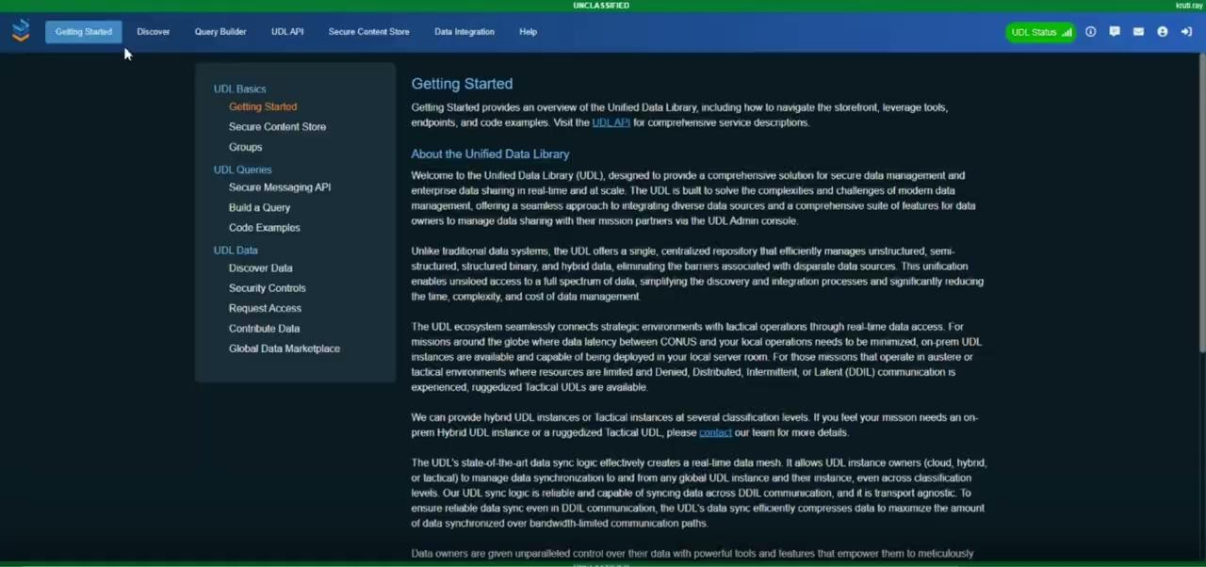
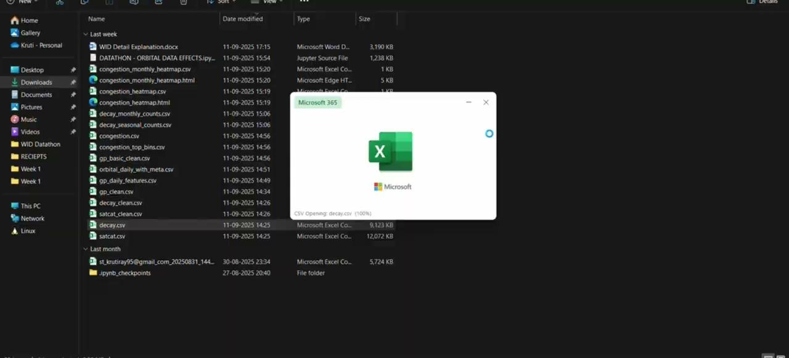
Approach
The Stellars
Datathon 2025

Slide 8
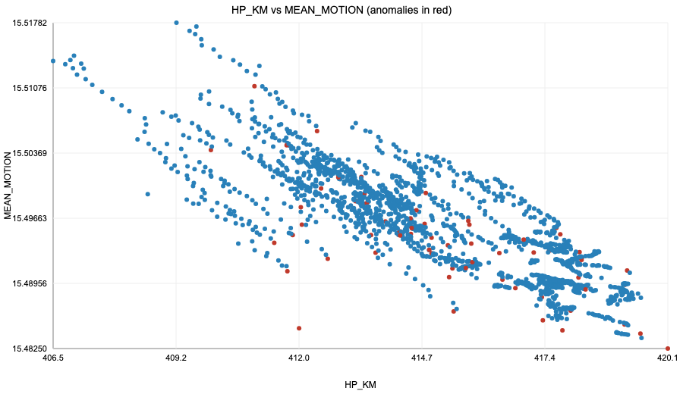
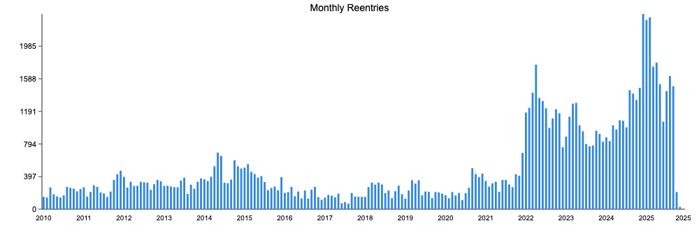
Key Findings
Detecting Orbital Anomalies
Decay Events Are Clustered
~3.5% of satellite orbital records flagged as anomalies using Z-score thresholds. It confirms our pipeline can detect unusual drag or orbital drift reliably.
Decay reentries show clear surges — stable through 2010–2018, rising from 2021, and peaking late 2024–early 2025 (≈2,300+ monthly reentries). It indicates external triggers (e.g., space weather storms, congestion) and validates the need for predictive modeling.
The Stellars
Datathon 2025

Slide 9
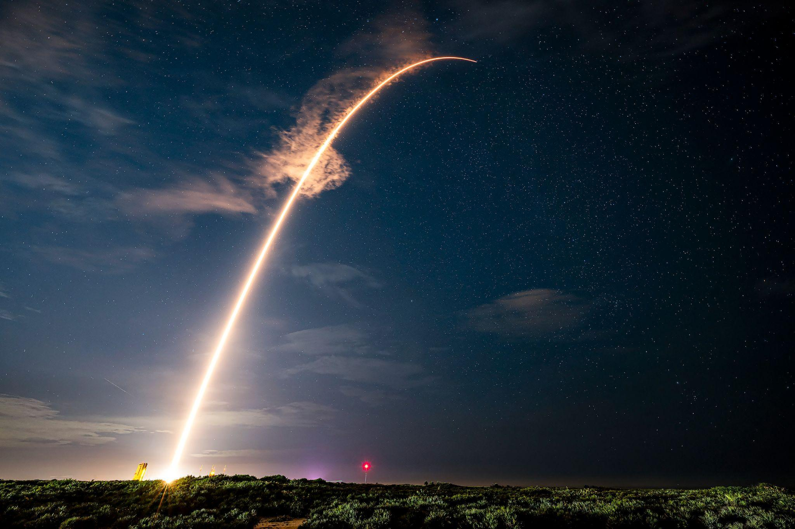
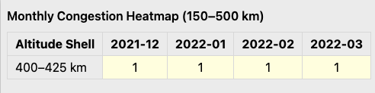
Starlink Case Study
38 Satellites Lost
Event: Feb 2022 geomagnetic storm caused 38 Starlink satellites to fail within days of launch.
Cause: Increased atmospheric drag (captured by BSTAR spikes) + low-altitude injection at 400–425 km.
Insights: Satellites showed HP_KM drops, mean motion uptick, and BSTAR spikes under drag stress, with 400–425 km congestion compounding risk.
Impact: Combining anomaly detection with congestion heatmaps could have flagged the risk early, underscoring the value of early warning systems for mega-constellations like Starlink.
The Stellars
Datathon 2025

Slide 10
VISUALIZATIONS
Solution or Tool Highlights (1 minute)
Summarize your project deliverable (e.g., prototype dashboard, risk model, report).
Emphasize how your solution contributes to better space situational awareness.
Discuss its potential applications, scalability, or ethical considerations.
If applicable, describe how your work improves accessibility or understanding of complex space data.
Link to Github
Click Here
The Stellars
Datathon 2025

Slide 11
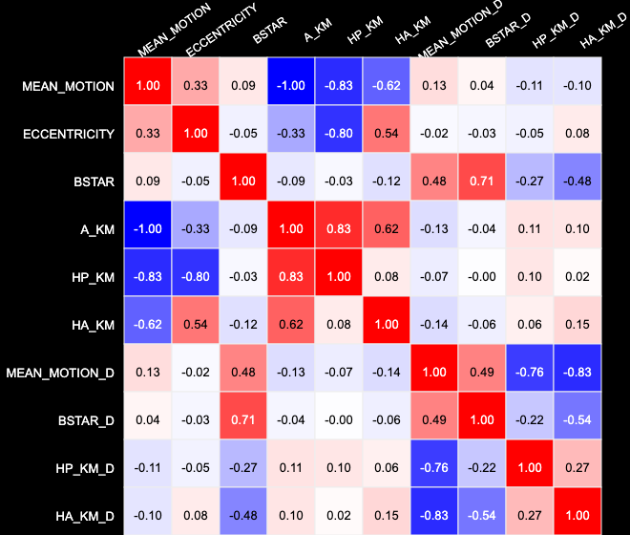
Feature Correlations in Orbital Data
Strong negative correlation: HP_KM ↔ Mean Motion → perigee loss means faster orbit decay.
BSTAR positively correlated with anomalies → confirms drag as a key driver.
Helps researchers/operators understand which orbital features predict instability.
From research to operations, correlations connect orbital features to real-world decay and safety outcomes.
The Stellars
Datathon 2025

Slide 12
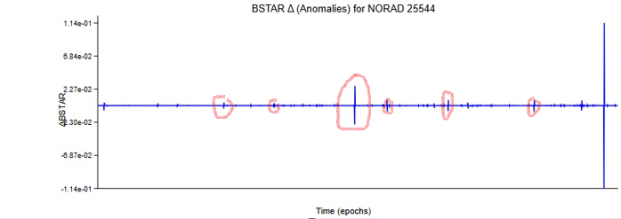
BSTAR Anomalies as Early-Warning for Operators
Operators (e.g., SpaceX, NOAA) can use these BSTAR spikes to trigger reboost maneuvers before decay risk increases.
BSTAR anomaly spikes = early drag signals.
Helps operators avoid unexpected reentries.
Supports safe maneuver planning.
For satellite operators: BSTAR anomaly monitoring enables proactive maneuvers, reducing reentry losses and enhancing mission safety.
The Stellars
Datathon 2025

Slide 13
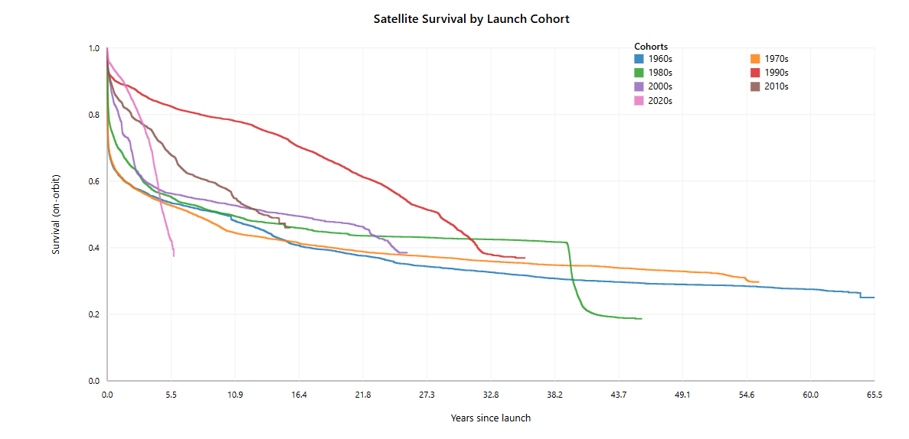
Satellite Survival by Launch Cohort
Shows how long satellites from different launch decades survive in orbit.
Older cohorts (1960s–1990s) decayed faster due to weaker designs & higher drag.
Modern constellations (2010s–2020s) survive longer, but storms still cause sharp drops.
Helps operators & policy makers benchmark design lifetimes and set debris mitigation policies.
For policy makers & regulators: survival analysis guides safe deorbit timelines and sustainable constellation planning.
The Stellars
Datathon 2025

Slide 14
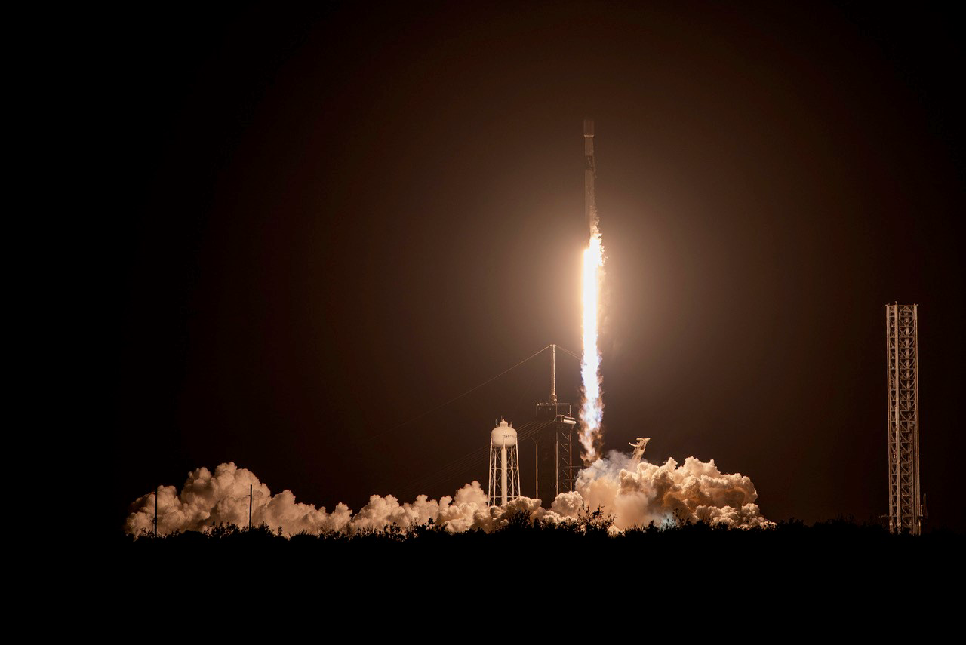
Recommendations
Our successful partnerships
For Operators (e.g., SpaceX, NOAA): Adopt BSTAR anomaly monitoring to trigger early reboost maneuvers.
For Insurers & Risk Managers: Integrate congestion heatmaps into risk models to refine premium pricing and liability coverage.
For Policymakers: Encourage space-weather-aware deployment protocols to reduce systemic risks in crowded shells.
For Researchers: Use correlation insights to refine predictive models of orbital decay and anomaly events.
The Stellars
Datathon 2025

Slide 15
Conclusion
Early anomaly detection can provide operators with actionable alerts, preventing unexpected reentries.
Congestion heatmaps help insurers and regulators quantify orbital risk zones, guiding smarter policies and pricing.
Feature correlations (HP_KM, BSTAR, Mean Motion) confirm drag as a key instability driver → strengthens predictive models.
Our approach demonstrates a scalable pipeline for mega-constellations, enhancing global space situational awareness (SSA).
Henceforth, by combining anomaly detection, clustering, and congestion analysis, we take a step closer to safer, more predictable orbital environments.
The Stellars
Datathon 2025

